Slide 1

Holotomy [Working Title]
Zellian Dettmer
IGME.690.01
Professor. Jake Adams

Slide 2
Milestone 2

Slide 3
So why create this?
As with many projects created during college the goal is to be able to put this into my portfolio. Why I chose to create a simplistic holographic dissection experience is because I am working to centralize my portfolio. My goal is to go into the medical field and be able to help create medical simulations to train and teach surgeons. While that is very big compared to the scope of this project, I want to utilize this software and use it as a starting point to continue to build off on. Using the theme of previous teachings to guide me as I work on this. It would be incredibly time consuming to make 1-to-1 models of each organ, so I am going to be working based off medical textbooks and the stylistic nature that those have, making it 3D, and applying it do a holographic, interactive experience.

Slide 4
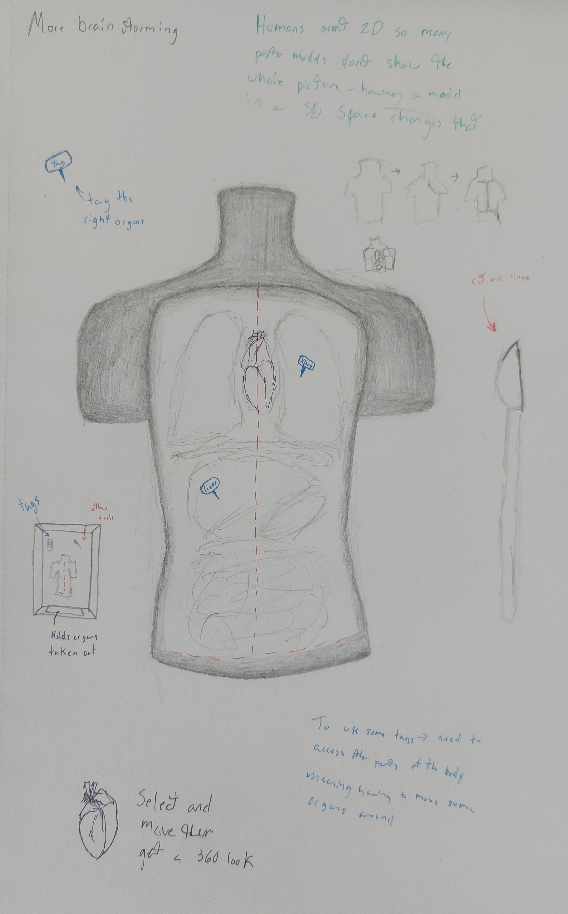
The Prototype
UI
An extreme user interface is not extremely needed for this interactive experience. There is nothing active the player needs to do, no stats to keep track of, no time to manage, it is meant to be a much more passive experience. That being said it is important to get an introductory sequence that explains how to utilize everything within the experience. To stay within the theme that sequence will have the feel of reading a book similar to the classic “once upon a time” book openings in movies.
3D Assets
There are 2 major sets of assets, the needed, and the would be nice to have.
The needed assets are the torso (without front skin), heart, lungs, liver, stomach, small and large intestines.
The would be nice to have includes, the torso (with front skin), scalpel, tags, additional organs (kidneys, diaphragm, etc)
Environment
The environment will be pretty simple and plain. The main focus is on the torso itself and not necessarily the background. The back environment would mimic book pages and the general feel of reading for hours and being “lost” in the pages.
Mechanics
The goal is for the mechanics to be forward. The use of a new device (leap motion) has me concerned playing with the functionality of that with Unity’s input system. At its core it has more of a “point and click” feel but with live motion scanning.
Interactions would include grabbing the scalpel and cutting into the torso, peeling the skin back to expose the chest cavity, “tagging” each organ, and the main interaction being able to pick up each organ and inspect it further. Being able to accomplish the first 3 interactions would be ideal but the main interaction goal is the movement and viewing of the organs utilizing the leap motion.

